Slide 1










Solution Architecture
Azure Cloud
Azure App Service
Azure OpenAI
GPT 3.5 Turbo
Frontend
Single Sign On
(SSO)
GPT 4 Turbo
Backend
OPEN AI
MODELS
ADA
User
Azure Active Directory

Slide 2

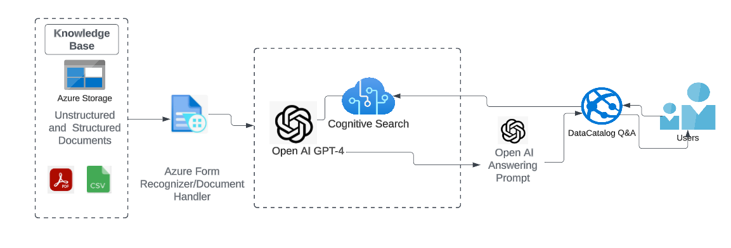
Solution Architecture

Slide 3






Azure OpenAI
GPT 4
GPT 3.5
Single Sign On
(SSO)
OPEN AI
MODELS
User
Data Catalog
QnA
Azure Cognitive Search
Microsoft Entra ID
Enterprise Data Source
Indexers
Index
Azure Blob Storage
Search API

Slide 4

File Upload – process flow
Azure Web app (ChatDSI)
Split the document into chunks and create embeddings
Ranked results
GPT 3.5 Turbo
Vector store
Document uploaded
(can be a PDF, DOCX, PPTX OR TXT)
Answer
Similarity search
question asked
Note: Documents are not stored for any purpose
User

Slide 5
Azure Web app (KUMO AI)
Split the document into chunks and create embeddings
Ranked results
GPT 4
Vector store
GPT 3.5
Document uploaded
(can be a PDF, DOCX, PPTX OR TXT)
Answer
Similarity search
question asked
Note: Documents are not stored for any purpose
User

Slide 6
File Upload – process flow
Azure Web app (KUMO AI)
Split the document into chunks and create embeddings
Ranked results
GPT 4
Vector store
GPT 3.5
Document uploaded
(can be a PDF, DOCX, PPTX OR TXT)
Answer
Similarity search
question asked
Note: Documents are not stored for any purpose
User

